Slide 1
Chapter 6
Control Statements

Slide 2
List of contents
Introduction to Control statements
The if statement
A word on indentation
The if….else statement
The if….elif…else statement
The while loop
The for loop
Infinite loops
Nested loops
The else suite
The break statement
The continue statement
The pass statement
The assert statement
The return statement

Slide 3
Introduction to Control statements
Control statements are the statements which control or change the flow of execution.
The following are the control statements available in python
The if statement
The if….else statement
The if….elif…else statement
The while loop
The for loop
The else suite
The break statement
The continue statement
The pass statement
The assert statement
The return statement

Slide 4
The if statement
This statement is used to execute one or more statements depending on whether a condition is True or not.
Syntax:
if condition:
Statements
First the condition is tested, if the condition is True, then the statements given after colon(:) are executed
Here if statement ends with a colon(:) is called as header and its body is called as suite.

Slide 5
A word on indentation
Understanding indentation is very important in python
Indentation refers to spaces that are used in the beginning of a statement.
A header, which begins with a keyword and ends with a colon
The statements with same indentation belongs to the same group called a suite
By default, python uses 4 spaces but it can be increased or deceased by the programmer
Go to Jupyter notebook for examples

Slide 6
The if….else statement
The if….else statement executes a group of statements when its condition is True, otherwise, it will execute another group of statements.
Syntax:
if condition:
statements1
else:
statements2
Go to Jupyter notebook for examples

Slide 7
The if….elif…else statement
Sometimes, the programmer has to test multiple conditions and execute statements depending on those conditions.
The if….elif…else statement is useful in such situations.
Syntax:
if condition:
statements
elif condition:
statements
elif condition:
statements
else:
statements
Go to Jupyter notebook for examples

Slide 8
The while loop
It is useful to execute a group of statements several times reputedly depending on whether a condition is True or False
First python interpreter checks the condition, if it is True then it will execute the statements written after colon(:) or its suite.
Then it will go back to check the condition once again. If the condition is True, it will execute the statements in its suite. It will repeat until the condition is found False
Syntax:
while condition:
statements
Go to Jupyter notebook for examples

Slide 9
The for loop
The for loop is useful to iterate over the elements of a sequence.
It means, for loop can be used to execute a group of statements repeatedly depending upon the number of elements in the sequence.
The for loop can work with sequence like string, list, tuple, range etc.
Syntax:
for variable in sequence:
statements
Go to Jupyter notebook for examples

Slide 10
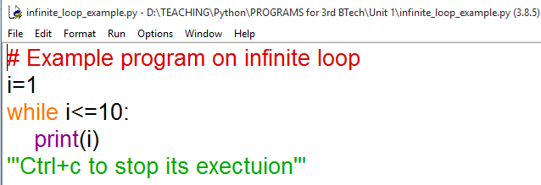
Infinite loops
A loop that continue to execute its suite for infinity number of times (ie., it will go on executing the statements in the suits) those loop is called as an infinite loop
For example:
Go to Jupyter notebook for more examples

Slide 11
Nested loops
It is possible to write one loop inside another loop
A loop inside another loop is called nested loop
For example, we can write a for loop inside a while loop or a for loop inside another for loop
Go to Jupyter notebook for examples

Slide 12
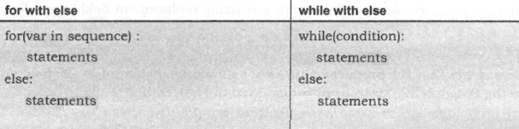
The else suite
In python, it is possible to use ‘else’ statement along with for loop or while loop
Go to Jupyter notebook for examples

Slide 13
The break statement
The break statement can be used inside a for loop or while loop to come out of loop
When ‘break’ is executed, the python interpreter jumps out of the loop to process the next statement in the program
Go to Jupyter notebook for examples

Slide 14

The pass statement
The continue statement
The continue statements is used in a loop to go back to the beginning of the loop.
It means, when continue is executed, the next repetition will start.
When continue is executed, the subsequent statements in the loop are not executed.
The pass statement does not do anything.
Go to Jupyter notebook for examples

Slide 15
The assert statement
The assert statement is useful to check if a particular condition is fulfilled or not.
Syntax:
assert expression, message
Here message is optional
Go to Jupyter notebook for examples

Slide 16
The return statement
A function is a group of statements to perform a task
The purpose of a function is to perform some task and in many cases it returns the result
A function states with the keyword def
‘return’ keyword is used to through the result of the function
Syntax:
return expression
When a function does not return anything, then there is no need to write the return statement
Go to Jupyter notebook for examples

